Slide 1
Synonyms
Grade 5/6 Whole Class

Slide 2
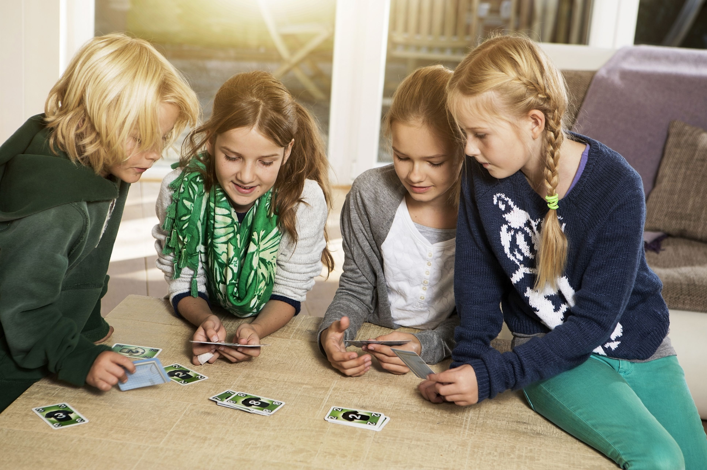
Plans for Today
First, we read a book
Second, we talk about it
Third, we do an activity

Slide 3
Introduction and Reading

Slide 4
What is an antonym?
An antonym is …

Slide 5
What is a synonym?

Slide 6
Read a book and think
What is a synonym?
A synonym is a word that means the same or almost the same
What functions do synonyms have?
it helps …
it can …
with it, we can …

Slide 7
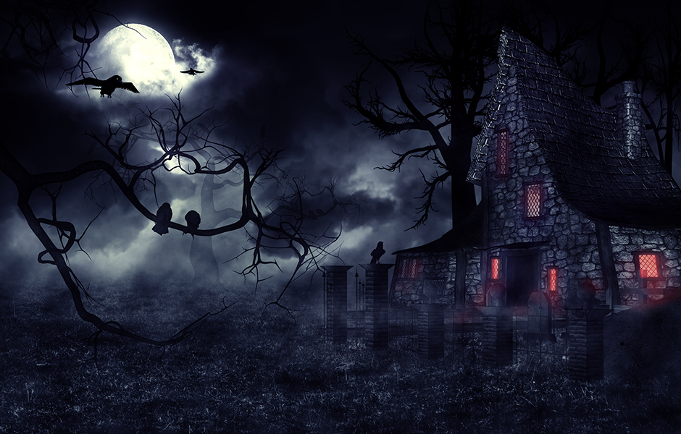
What are synonyms of “spooky?”
Creepy
Scary
Mysterious
Haunted
Freaky
Dark
Terrifying
Notes:
Eerie, uncanny, weird, frightening, terrifying, spine-chilling, scaring

Slide 8
Synonym Partner Game

Slide 9
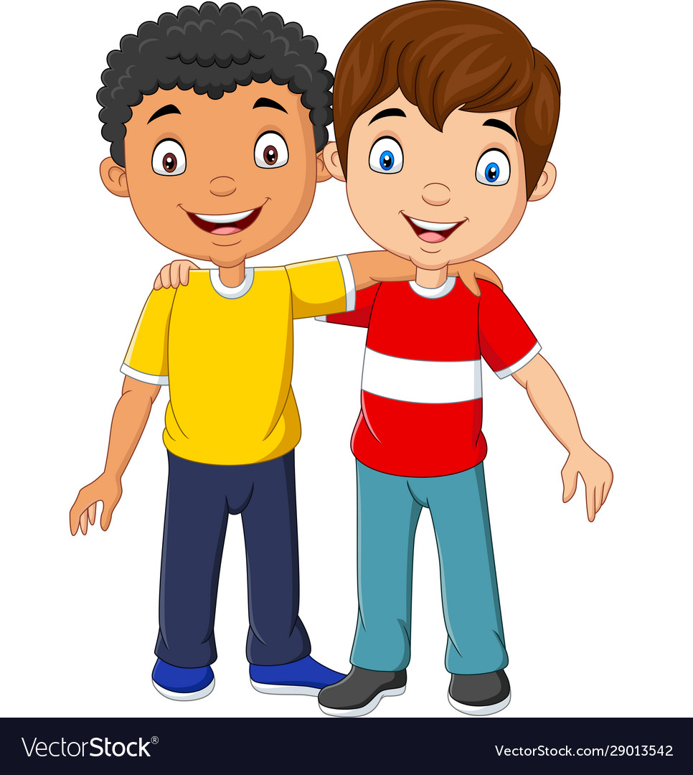
Find your partner!
Game: Find the person who has a synonym of your word.

Slide 10
Plans for Today
First, we review what we learned
Second, we look for synonym partners
Third, we play a whole-class game

Slide 11
What is a synonym?

Slide 12
Circle the Synonyms

Slide 13
Do you still remember what synonyms mean?

Slide 14
Which is the synonym of happy?
sad
upset
glad
fast

Slide 15
Which is the synonym of happy?
sad
upset
glad
fast

Slide 16
Do you know other synonyms of happy?
Excited
Joyful
Glad
Content
proud
Notes:
Joyful, cheerful, jolly, gleeful, content, delightful

Slide 17
Which is the synonym of laugh?
stare
giggle
frown
talk

Slide 18
Which is the synonym of laugh?
stare
giggle
frown
talk
Notes:
Do you know other words for “laugh?”

Slide 19
Do you know other synonyms of laugh?
Chatter
Giggle
lol
Notes:
Chuckle, chortle

Slide 20
Which is the synonym of repair?
broken
break
fix
continue

Slide 21
Which is the synonym of repair?
broken
break
fix
continue

Slide 22
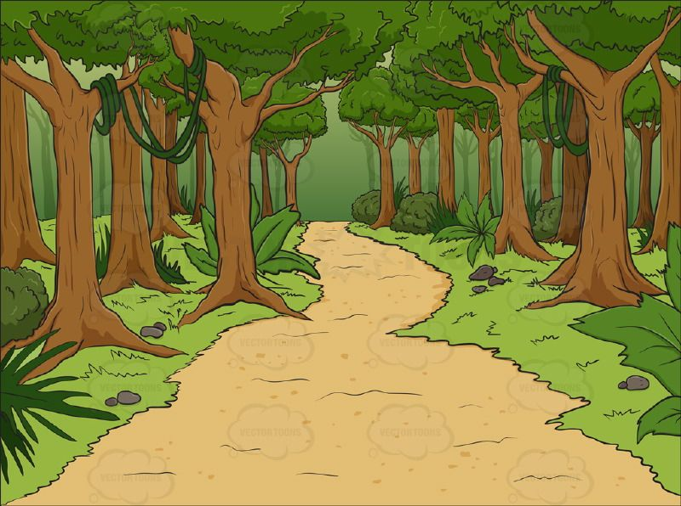
Which is the synonym of forest?
farm
land
grass
woods

Slide 23
Which is the synonym of forest?
farm
land
grass
woods

Slide 24
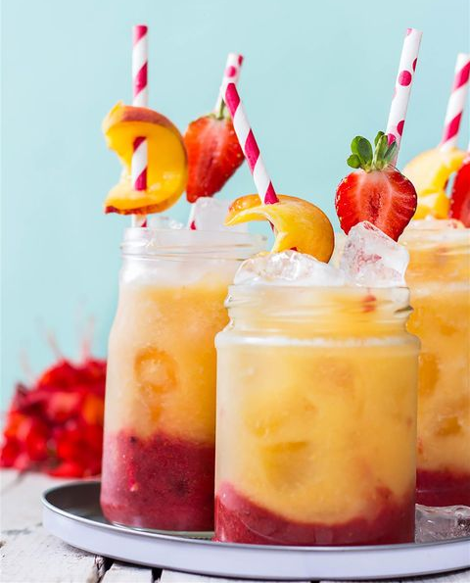
Which is the synonym of drink?
hot
meal
beverage
dinner

Slide 25
Which is the synonym of drink?
hot
meal
beverage
dinner

Slide 26
Synonym Partner Game

Slide 27
Shades of meanings

Slide 28
Shades of meanings
 | warm | hot | boiling

Slide 29
Shades of meanings
big
huge

Slide 30
Shades of meanings
good
great
superb

Slide 31
Find your partner(s)!
Game: You may find more than one synonyms!

Slide 32
Fishing Game

Slide 33
Rules
Blue Team vs. Red Team will take turns to play

Slide 34
Rules
Blue Team vs. Red Team will take turns to play
Use your word to fish the synonyms in the pool

Slide 35
Rules
Blue Team vs. Red Team will take turns to play
Use your word to fish the synonyms in the pool
You can fish more than one word if they are all synonyms of your card

Slide 36
Rules
Blue Team vs. Red Team will take turns to play
Use your word to fish the synonyms in the pool
You can fish more than one word if they are all synonyms of your card
When there are no more fish, say “I have ____” and see if your teammate can fish it

Slide 37
Rules
Blue Team vs. Red Team will take turns to play
Use your word to fish the synonyms in the pool
You can fish more than one word if they are all synonyms of your card
When there are no more fish, say “I have ____” and see if your teammate can fish it - The other team may fish your card too!

Slide 38
Rules
Blue Team vs. Red Team will take turns to play
Use your word to fish the synonyms in the pool
You can fish more than one word if they are all synonyms of your card
When there are no more fish, say “I have ____” and see if your teammate can fish it - The other team may fish your card too!
The wordlist is here

Slide 39
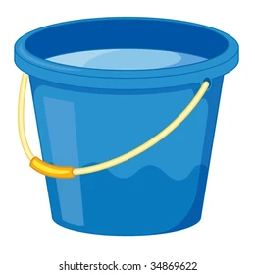
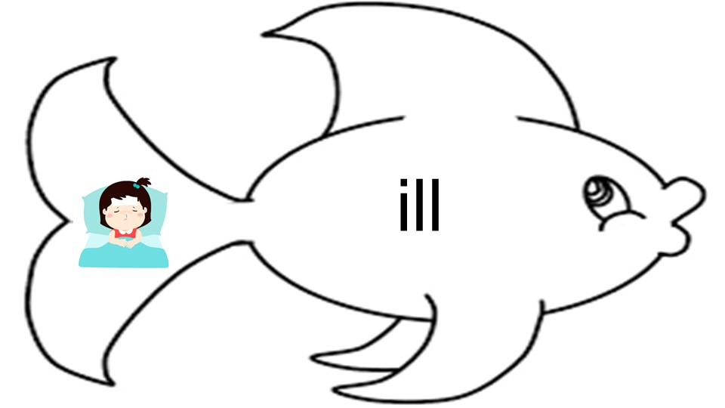
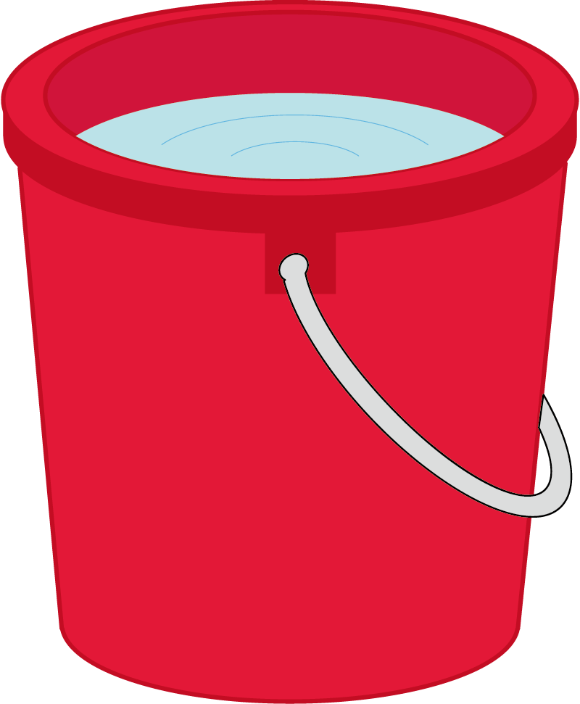
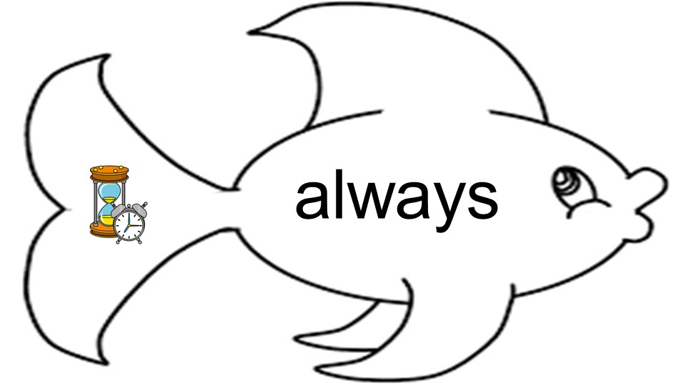
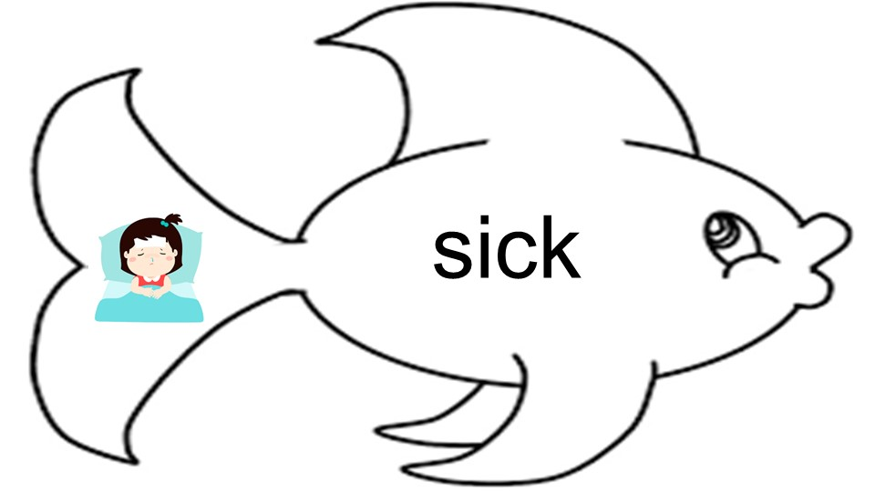
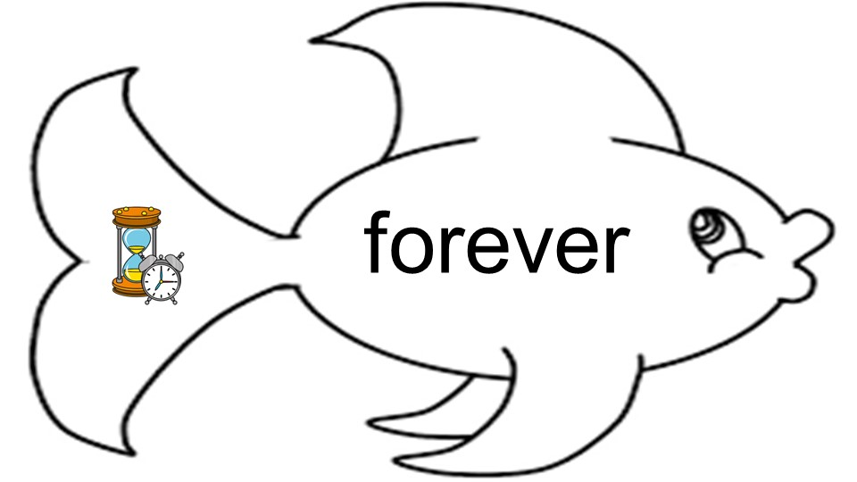
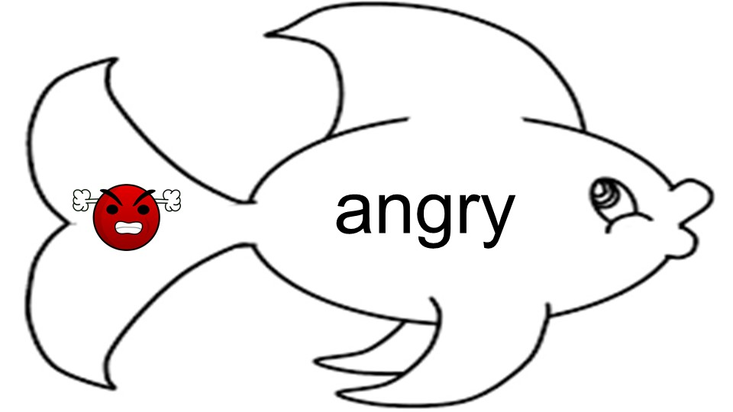
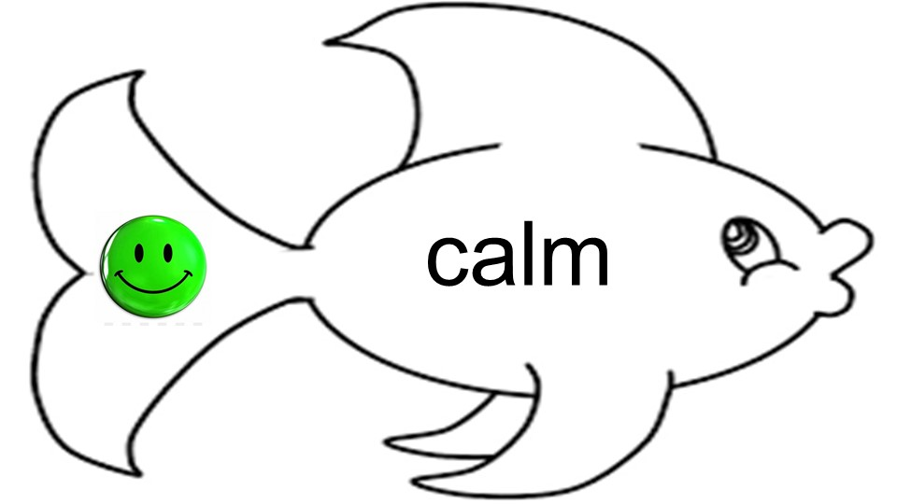
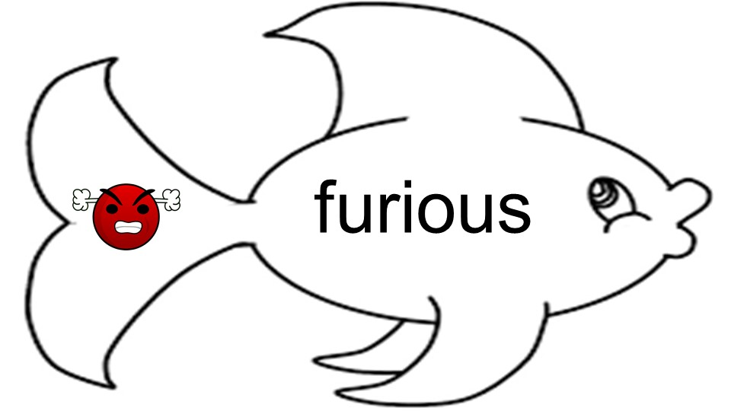
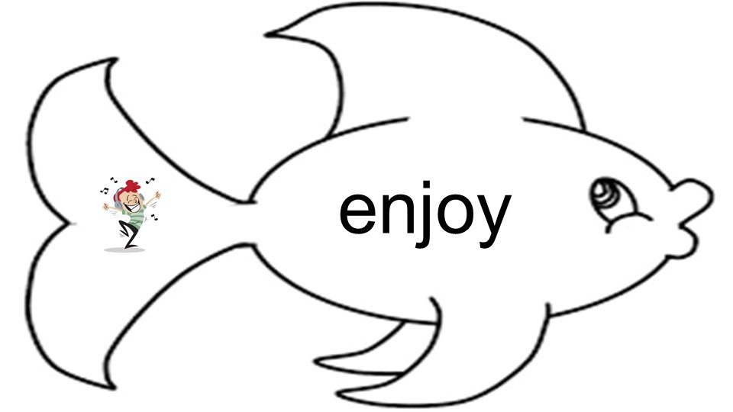
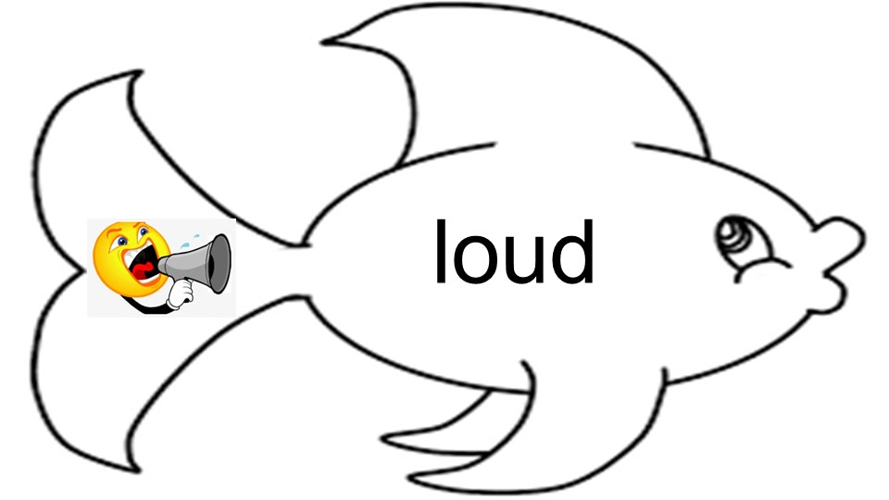
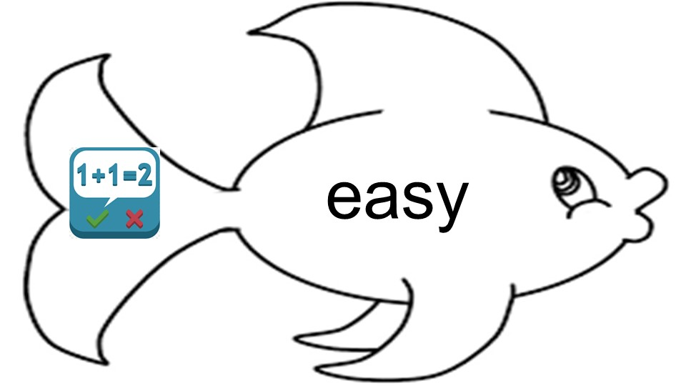
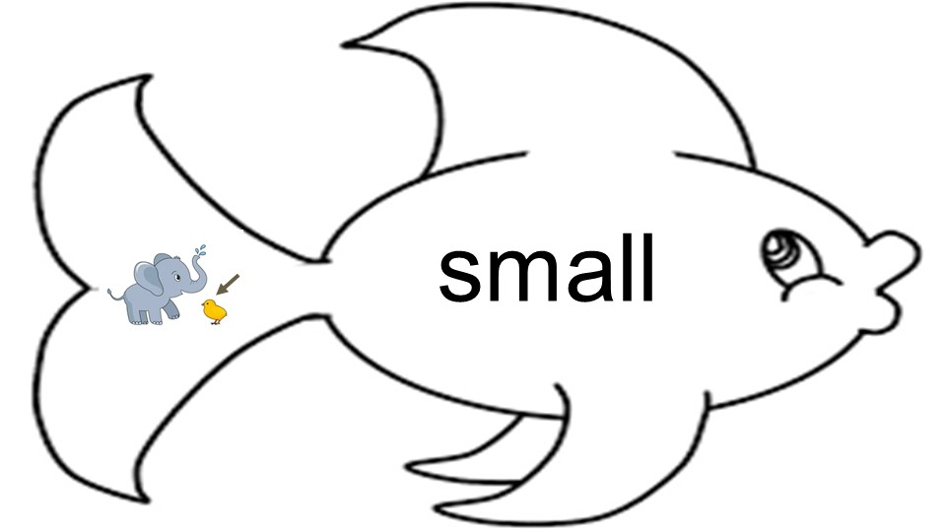
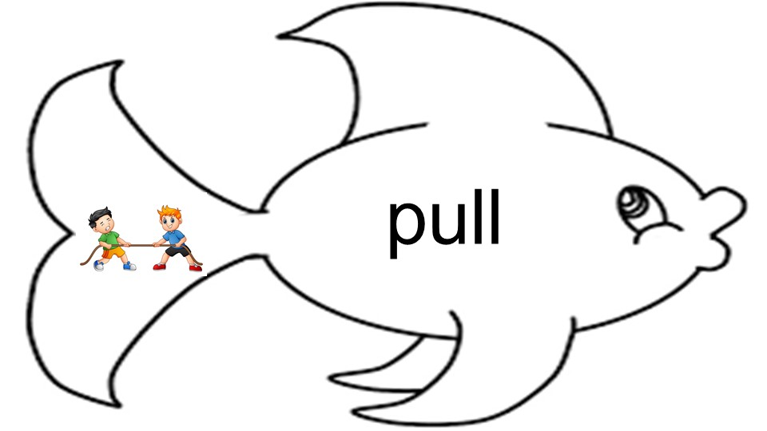
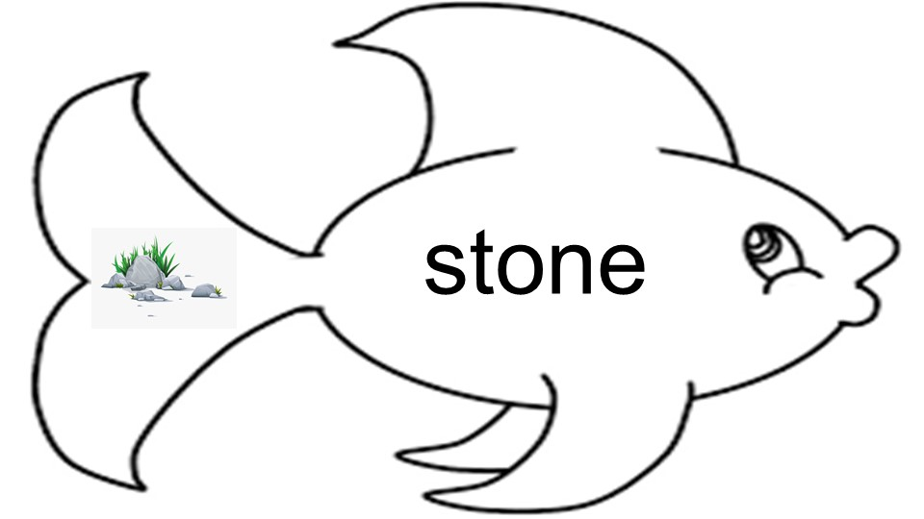
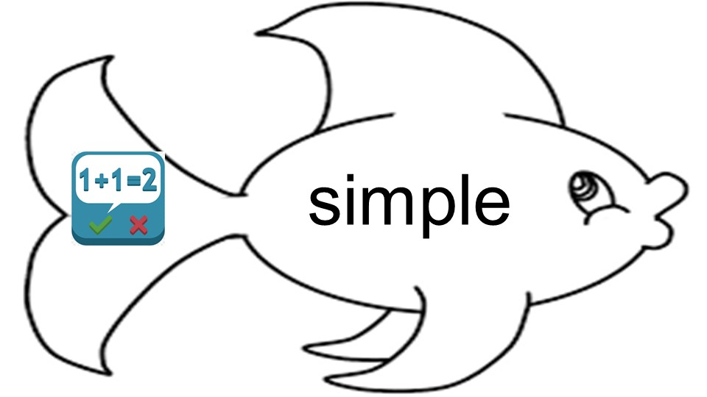
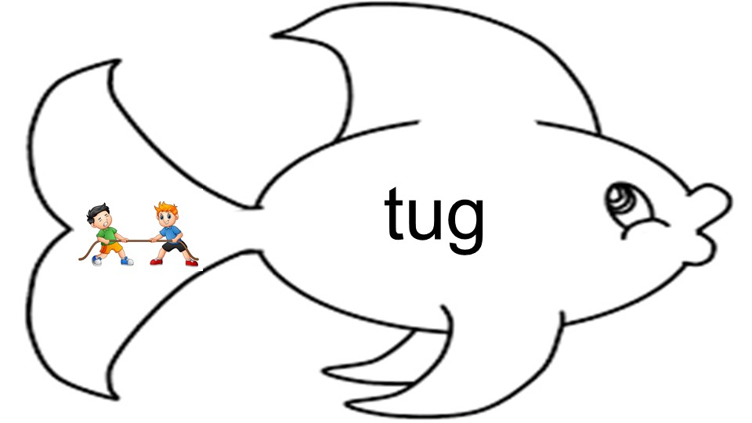
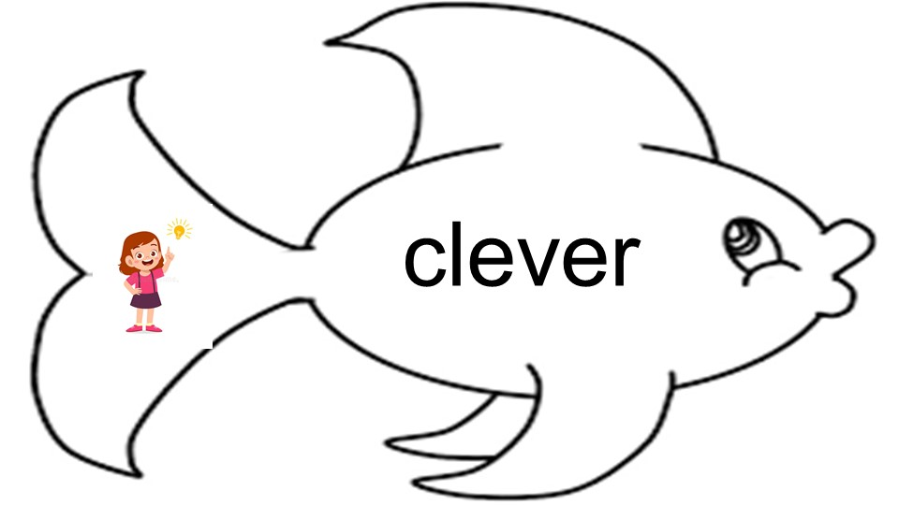
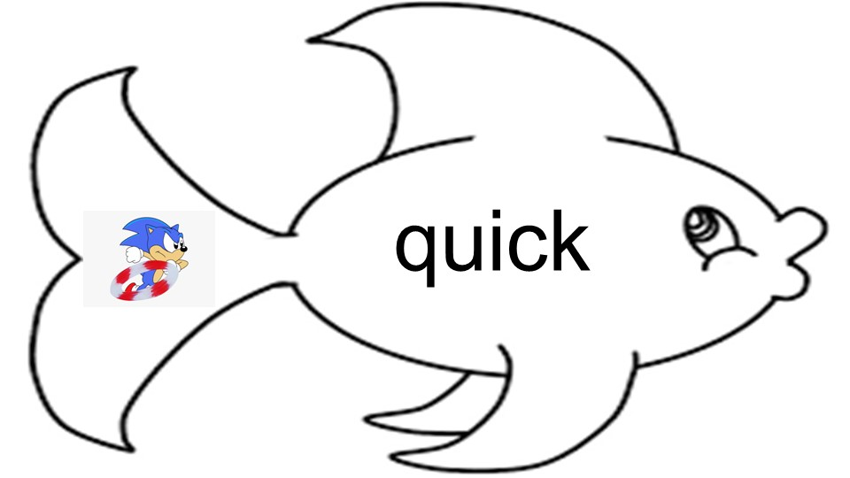
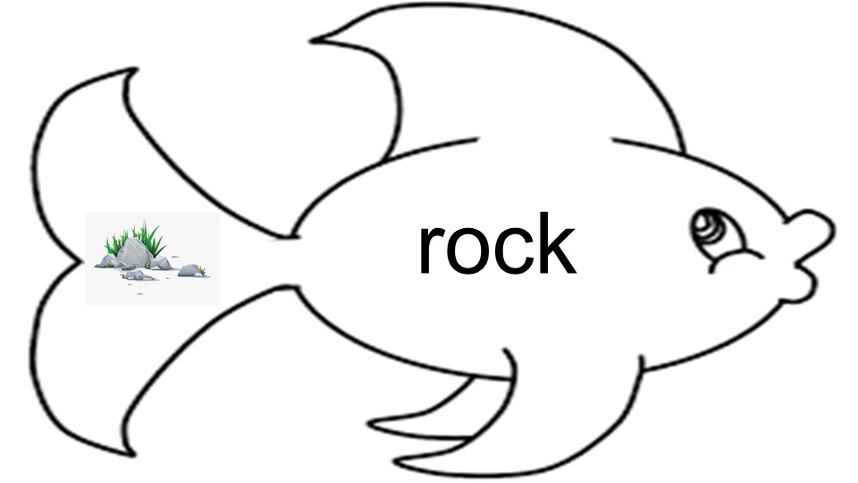
0 fish
0 fish

Slide 40
Revise the Paragraphs

Slide 41
Do you still remember what synonyms mean?

Slide 42
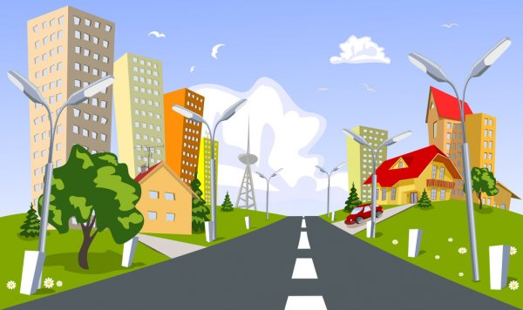
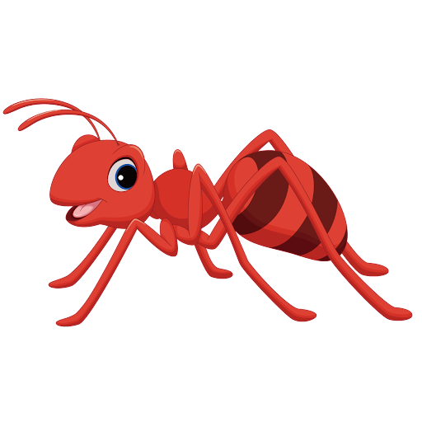
Little red ant comes onto the street.
He sees big flowers, big cars, big houses, and a big tower.
Notes:
Revise on the latter page, keep this page unchanged

Slide 43
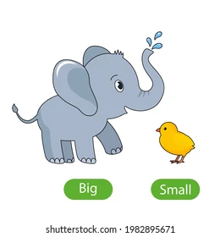
Big
Large
Huge
Giant
Gigantic
Humongous
Vast
Massive

Slide 44
Little red ant comes onto the street.
He sees big flowers, big cars, big houses, and a big tower.

Slide 45
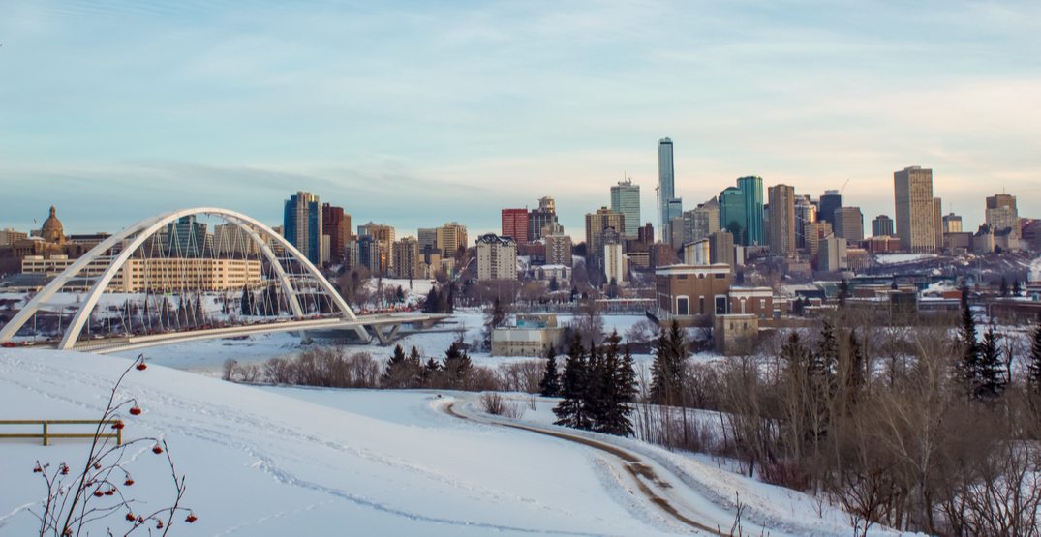
Edmonton’s winter is cold. It is cold downtown and cold by the river. It is cold when you stay outside and also cold when you are indoors. In the night, it is very cold!
Notes:
Revise on the latter page, keep this page unchanged

Slide 46
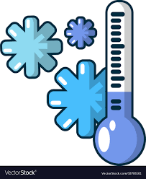
Cold
Chilly
Freezing
Wintry
Frigid
Cool
Freezing
Numbing
Piercing

Slide 47
Edmonton’s winter is cold. It is cold downtown and cold by the river. It is cold when you stay outside and also cold when you are indoors. In the night, it is very cold!

Slide 48
How did synonyms help us with writing?

Slide 49
Synonym and Antonym Game

Slide 50
What are …
Synonyms
Antonyms

Slide 51
Shades of meanings

Slide 52
Shades of meanings
freezing | cold | cool |  | warm | hot | boiling

Slide 53
Shades of meanings
good
bad
awful
great
superb

Slide 54
Shades of meanings
always
sometimes
never
often
seldom

Slide 55
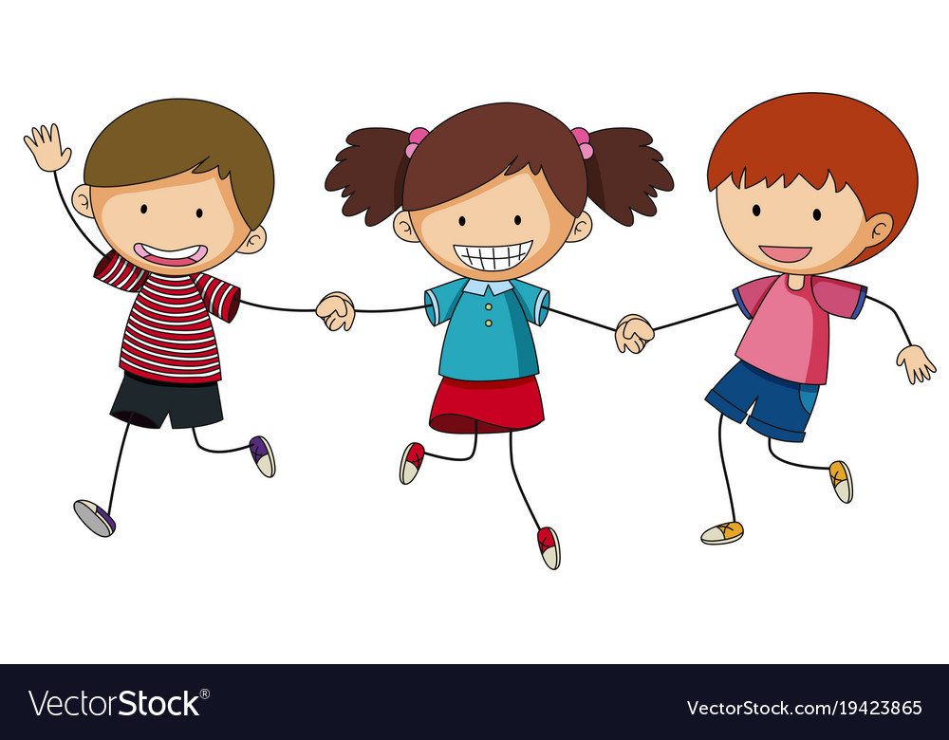
First, find your synonym partners

Slide 56
First, find your synonym partners
Then, meet with your antonym group

Slide 57
First, find your synonym partners
Then, meet with your antonym group
There may be more than two synonyms!

Slide 58
Review
What are synonyms? Examples?
What are antonyms? Examples?

